Slide 1

Movie Recommendation System
Cherukuri Vandana - 700759337
Apoorva Kyramkonda - 700742326
Naveen Panneti - 700757541
Vennela Madamshetty - 700736655

Slide 2

Introduction
The Movie Recommendation System is a dynamic web application developed using Python Django, HTML, CSS, Bootstrap, and JavaScript. Hosted on AWS EC2, the system employs a serverless architecture, utilizing AWS services like API Gateway, Lambda, DynamoDB, and CloudWatch. The front end, designed with Bootstrap, ensures a responsive and visually appealing user interface. IAM roles are meticulously implemented for secure access control. The system's core functionality relies on DynamoDB for flexible data storage and Lambda for serverless computations. Monitoring and logging are handled by CloudWatch. The project represents an innovative integration of cloud computing, web development, and data management to deliver personalized movie recommendations.

Slide 3



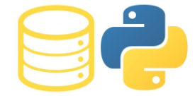

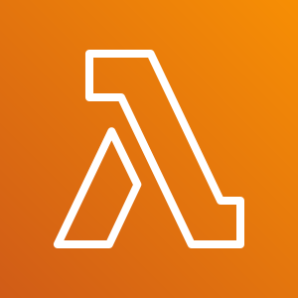



Architecture Diagram
EC2 instance
(Web server)
Invoke API call
DynamoDB
Endpoint
API GW
Lambda
AWS Identity and Access Management (IAM)
CloudWatch

Slide 4
Services Used
AWS API Gateway
AWS Lambda
AWS CloudWatch
AWS IAM
AWS DynamoDB
AWS EC2
Django Framework

Slide 5
AWS API Gateway
Amazon API Gateway is a fully managed service that makes it easy for developers to create, publish, maintain, monitor, and secure APIs at any scale.
APIs act as the "front door" for applications to access data, business logic, or functionality from your backend services.
Using API Gateway, you can create RESTful APIs and WebSocket APIs that enable real-time two-way communication applications.
API Gateway supports containerized and serverless workloads, as well as web applications.
API Gateway has no minimum fees or startup costs. You pay for the API calls you receive and the amount of data transferred out and, with the API Gateway tiered pricing model, you can reduce your cost as your API usage scales.

Slide 6
AWS LAMBDA
Serverless, event-driven compute service
Run code without provisioning or managing infrastructure.
Automatically respond to code execution requests at any scale.
Save costs by paying only for the compute time you use.
Optimize code execution time and performance with the right function memory size.

Slide 7
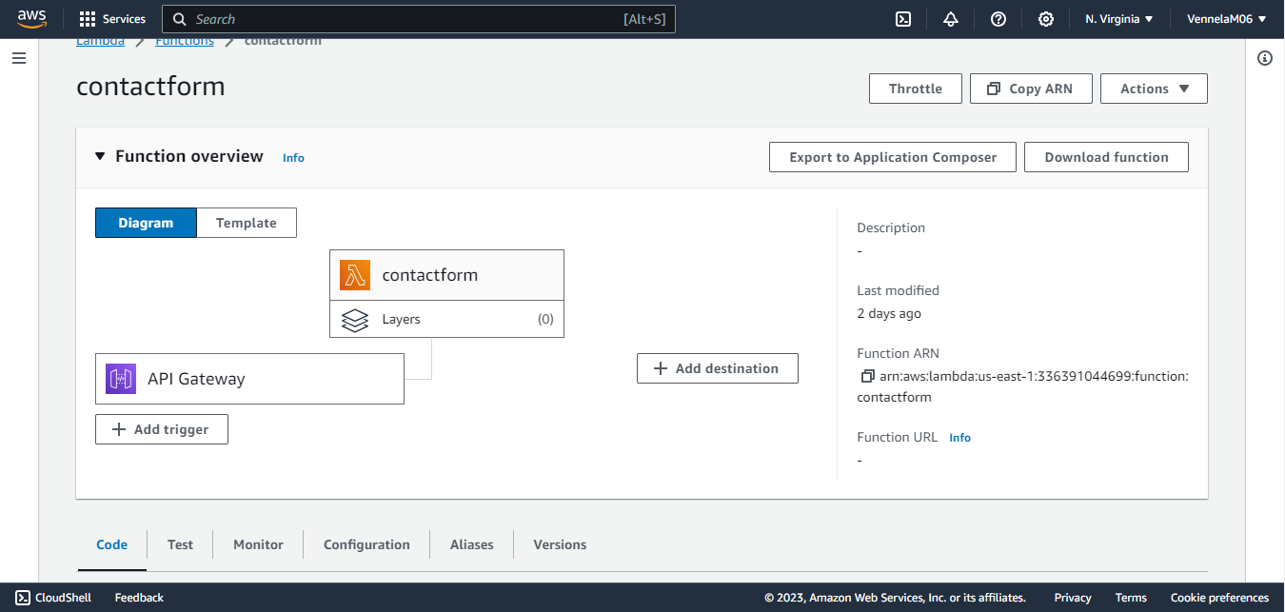

Slide 8
AWS CloudWatch
Monitoring and Observability for DevOps, developers, SREs, IT managers, and product owners
Actionable Insights: Monitor applications, respond to performance changes, and optimize resource utilization
Data Collection: Gathers logs, metrics, and events for a comprehensive view of operational health
Unified Visibility: Provides a unified view of AWS resources, applications, and on-premises services
Anomaly Detection: Identifies anomalous behavior in environments
Alarms and Automation: Set alarms, take automated actions, and troubleshoot issues
Visualization: View logs and metrics side by side for effective analysis
On-premises and AWS Support: Monitors applications and services in both environments
Ensures Smooth Operations: Discover insights to keep applications running smoothly

Slide 9
AWS IAM
AWS Identity and Access Management (IAM) is a web service for securely controlling access to AWS resources.
A principal is an entity that can perform actions on an AWS resource. A user, a role or an application can be a principal.
Authentication is the process of confirming the identity of the principal trying to access an AWS product
Request: A principal sends a request to AWS specifying the action and which resource should perform it.
Authorization: By default, all resources are denied. IAM authorizes a request only if all parts of the request are allowed by a matching policy.
Actions are used to view, create, edit or delete a resource.
Resources: A set of actions can be performed on a resource related to your AWS account.

Slide 10
AWS DYNAMODB
Fully Managed, Serverless NoSQL Database
Built-in Security with Encryption at Rest
Continuous Backups for Data Durability
Automated Multi-Region Replication for Availability
In-memory caching for Optimized Performance
Data Import and Export Tools for Seamless Operations
Predictable Performance and Seamless Scalability
Offloads Administrative Burdens: No Hardware Provisioning, Setup, or Configuration
Encryption at Rest Simplifies Protection of Sensitive Data
Alternative to Relational Databases for Simplified Scaling and Management

Slide 11
AWS EC2
Amazon EC2: Resizable compute capacity in the cloud
Simple Interface: Easy capacity configuration with minimal friction
Complete Control: Full control over computing resources
Broad and Deep Platform: Choice in processor, storage, networking, OS, and purchase model
Fastest Processors, 400 Gbps Networking: High-performance features
GPU Instances for ML and Graphics: Powerful options for specialized workloads
Dominance in Workloads: Leading in SAP, HPC, ML, and Windows workloads on AWS

Slide 12
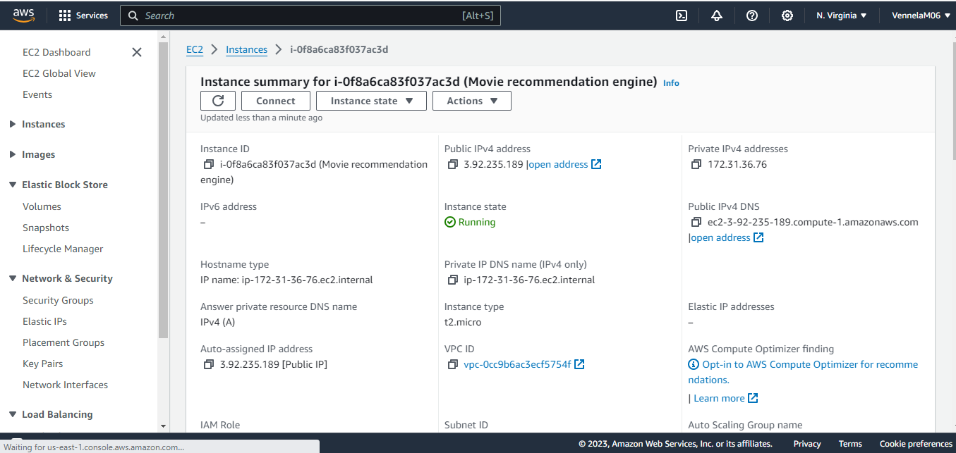

Slide 13
Technologies used
Python: The core programming language for backend development, offering versatility and ease of integration with various libraries.
Django: A high-level Python web framework used for building the application, providing a clean and pragmatic design.
HTML, CSS, Bootstrap: Frontend technologies employed to design an intuitive and visually appealing user interface, ensuring a seamless user experience.
Javascript: Enhances interactivity on the front end, enabling dynamic updates and improved user engagement.

Slide 14
DJANGO (PYTHON WEB FRAMEWORK)
High-level Python web framework.
Free and open-source.
Ridiculously fast.
Reassuringly secure.
Exceedingly scalable.

Slide 15
Features
User can register and login.
User can search through various movies and look through its details.
User can give rating to the movies.
User can add movie to their watch list.
User can get movie recommendation (Recommendation algorithm (Collaborative Filtering) which suggests new movies based on the ratings given by user.)

Slide 16
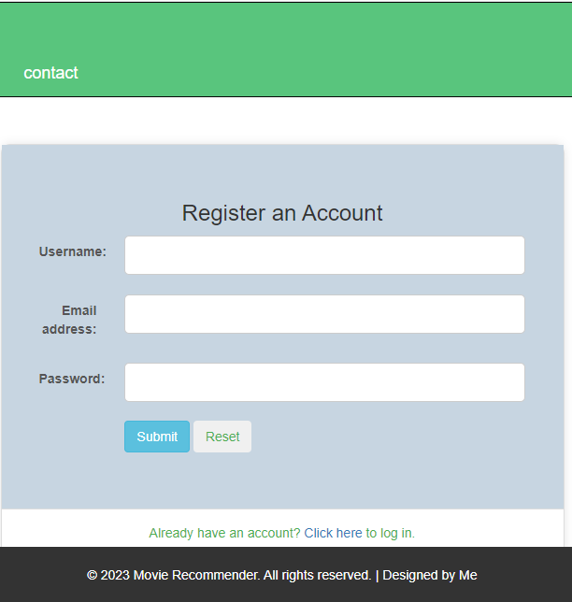
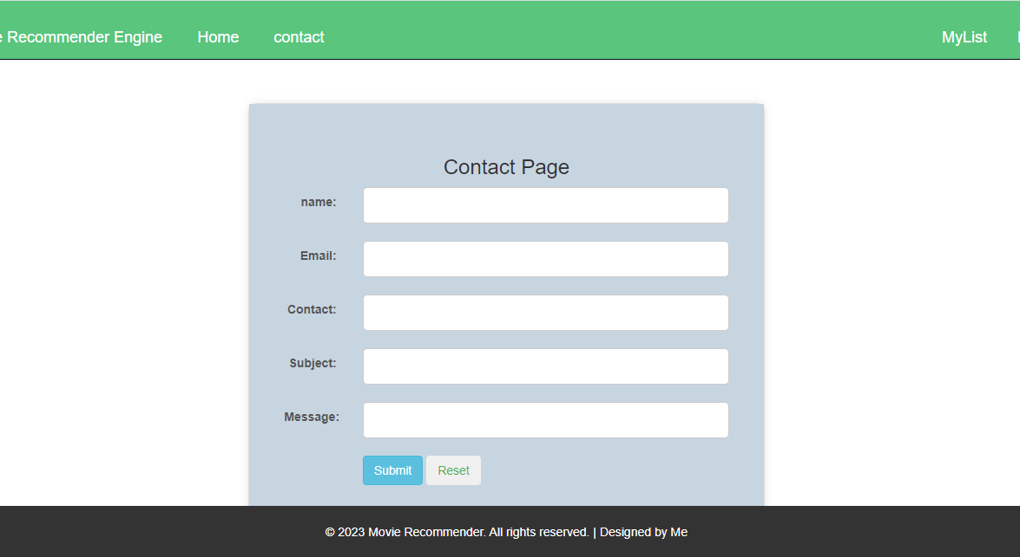
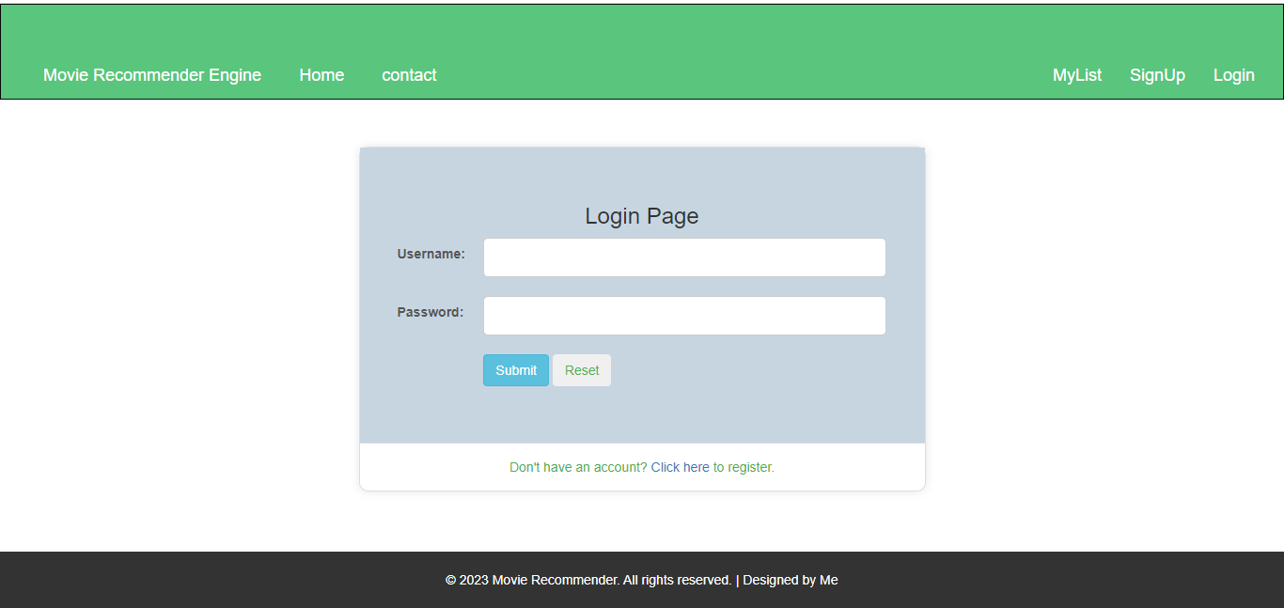

Slide 17
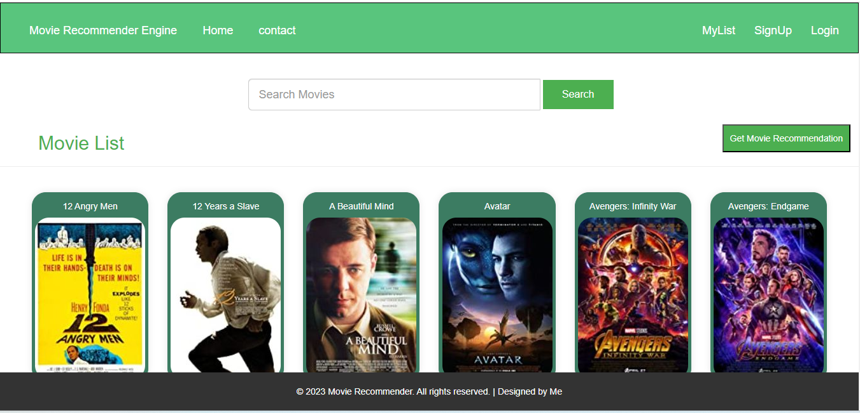
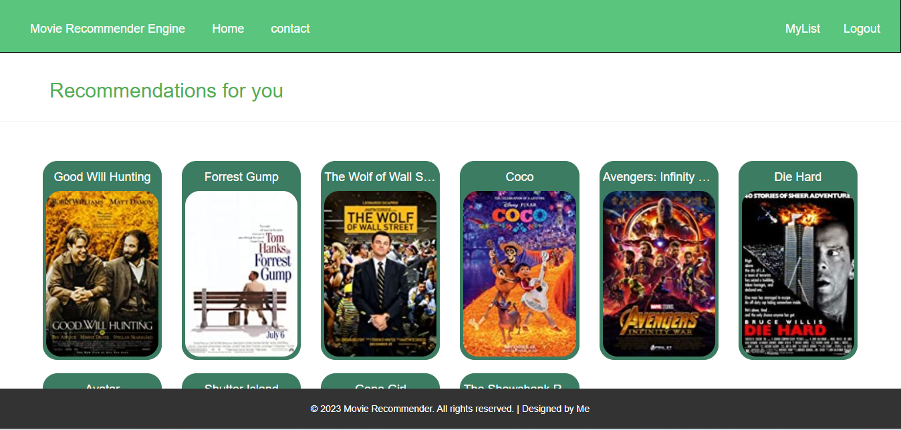

Slide 18
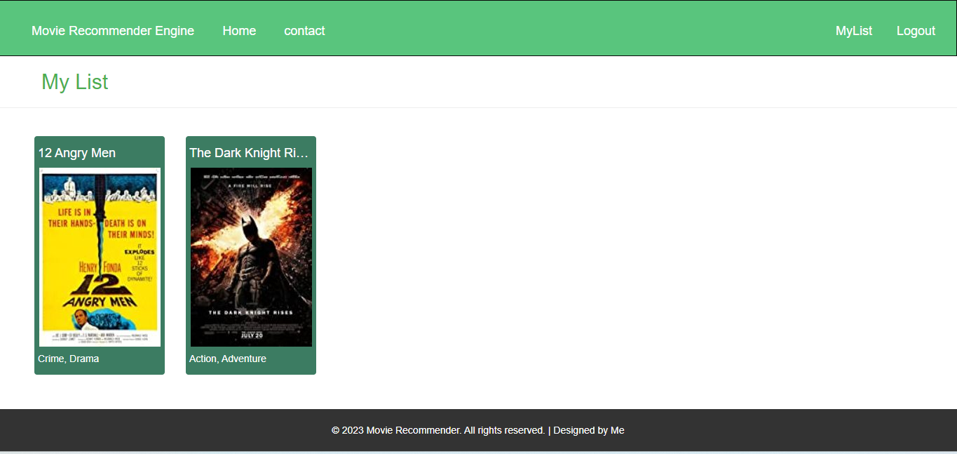
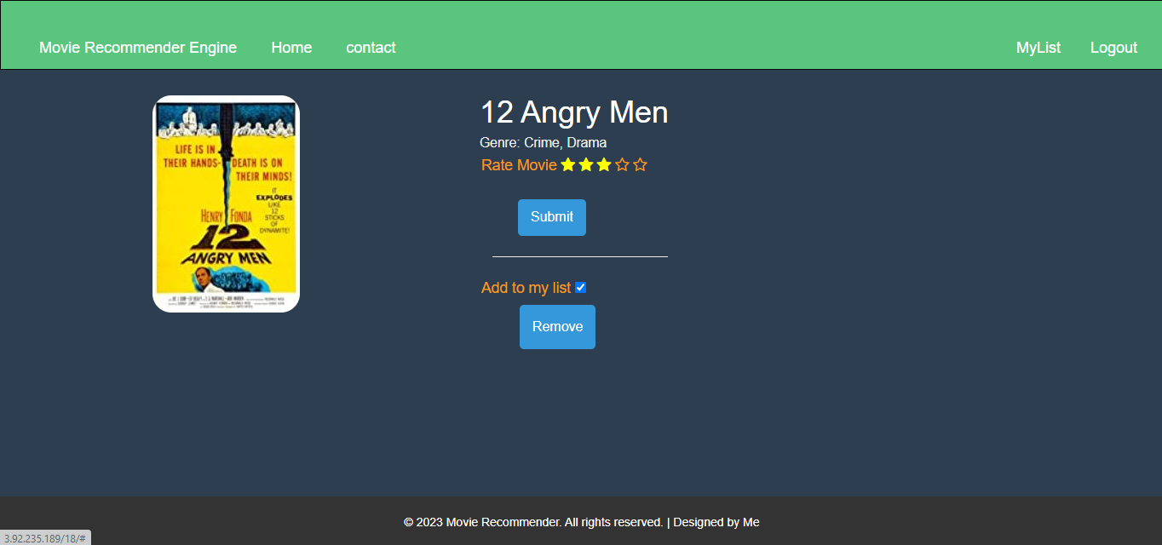

Slide 19
Conclusion
Movie Recommendation System on AWS Cloud represents a milestone in the fusion of advanced technologies and cloud computing solutions.
The project demonstrates the synergy between versatile backend processing, serverless computing, flexible data storage, robust monitoring, and secure access control.
The choice of Python as the primary programming language and Django as the web framework showcases a commitment to simplicity, readability, and rapid development.
As the digital landscape continues to evolve, this Movie Recommendation System exemplifies a forward-looking approach, providing users with an intelligent and personalized cinematic experience.

Slide 20

Thank you

